Slide 1
Types of Colonies in the Americas

Slide 2
Vocabulary
Word | Definition
Encomienda | Spanish economic system, where settlers were given land, and they were in control of that land and the people on it.
Plantation Colony | Colonies established to grow and sell cash crops
Cash Crop | crops grown in large amounts to sell
Trade Post Colony | Established to encourage commerce (trade)
Settler Colony | Established for permanent habitation (living)
Indentured Servant | Worked to pay off debts or the cost of traveling to the Americas
Viceroyalties | Royal representatives to monitor the colonies

Slide 3
The Americas
Who Came?
The Dutch
(Netherlands/Holland)
The French
(France)
The English (British)
(England)
The Portuguese
(Portugal)
The Spanish
(Spain)

Slide 4
American Colonies
The British, French, Dutch, Spanish and Portuguese established three different types of colonies:
- Trade-post colonies
- Plantation colonies
- Settler (permanent settlement) colonies
The type of colony depended upon the:
- Nation
- Geographic location
- Time period
- The resources available

Slide 5
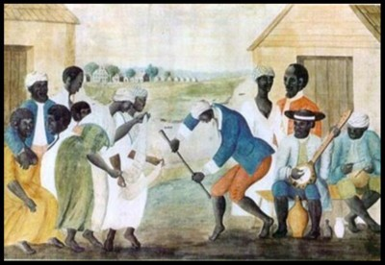
The Spanish & The Portuguese
Discovery of gold and silver combined with their social class system allowed the Spanish to dominate large parts of the Americas.
Both Spanish and Portuguese mainly established Plantation Colonies.
- Colonies established to grow and sell cash crops
Plantation colonies were dependent upon slave labor (Native American & African)
Grew “cash crops” – crops grown in large amounts to sell.

Slide 6
The Spanish & The Portuguese
Spain
Portugal

Slide 7
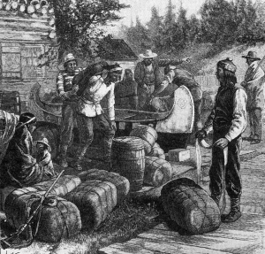
The French & The Dutch
The Dutch were the first to colonize and set up trading posts in South America.
- These colonies were not successful
Both French and Dutch established Trading Post Colonies.
Established to encourage commerce (trade).
The French had a good relationship with the Natives and traded furs with them
Their colonies were usually set up along water ways.

Slide 8
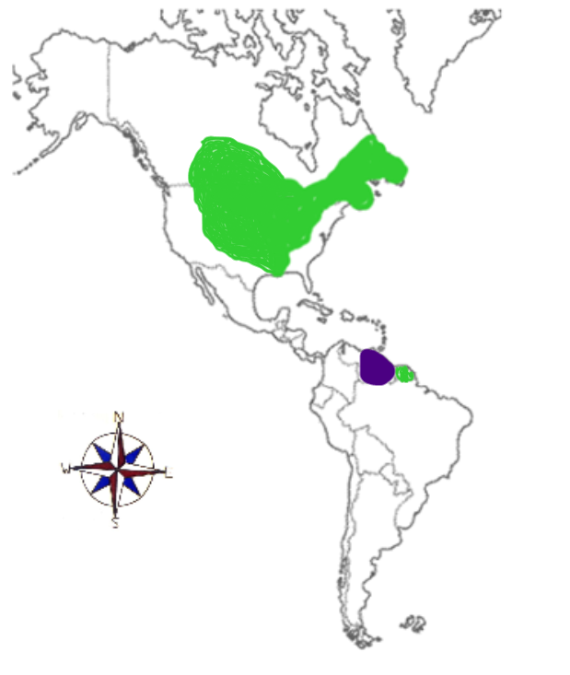
The French & The Dutch
France
Netherlands

Slide 9
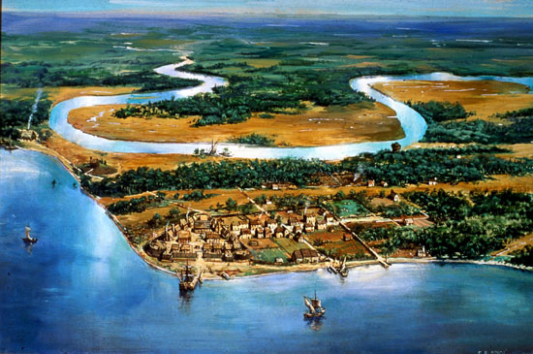
The British
Mainly established Settler (Settlement) Colonies.
Established for permanent
habitation (living)
Geographic Location: North America and the Caribbean
Started for trading, but eventually grew into cities. For example: Jamestown
Many Europeans, such as the Pilgrims, came looking to start new lives and gain religious freedom.
Some of these colonies had plantation systems which grew crops like tobacco, rice, indigo and sugar.

Slide 10
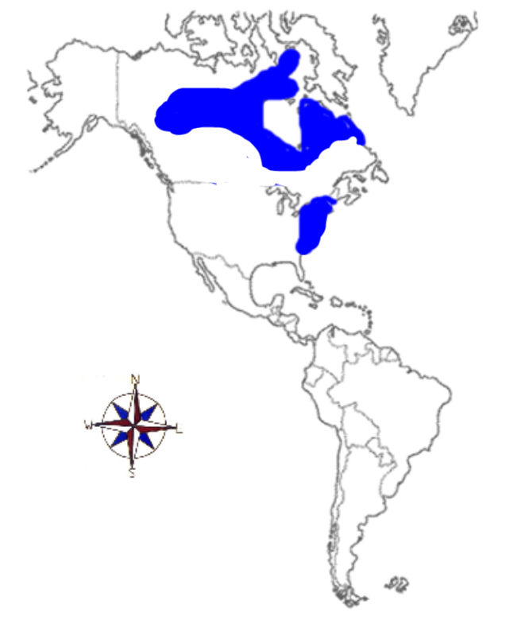
The British
England

Slide 11
Government in the Colonies
Spanish and Portuguese – ruled the colonies with the monarchy. The king sent viceroys (royal representatives) to monitor the colonies.
French and Dutch – were not strict and allowed the colonists choices in the political decisions.
English – set up representative government where colonists could choose representatives to participate in the decision making.

Slide 12
European Influence in the Americas

Slide 13
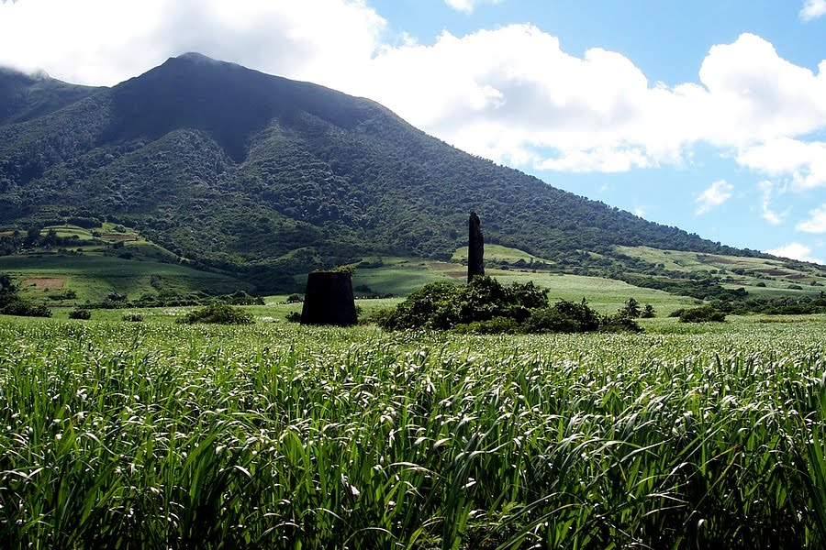
Colonization in the Americas
Unlike Asia, different types of colonies were set up in the Americas.
Spain and Portugal set up plantation colonies in Central and South America which grew sugar cane.
The French and Dutch also set up some plantation colonies in the Caribbean.
The English set up plantation colonies in the Southern English colonies which grew tobacco, rice, indigo, and some sugar cane.

Slide 14
Labor Shortage
The new colonies needed a great deal of labor.
Labor was especially needed on the plantations-large agricultural estates that produced cash-crops.
At first Native Americans were used but this was unsuccessful for two reasons.
They lacked immunity- the bodies ability to resist infection. And they died off by the thousands.
Also they were more capable of escaping because of their familiarity with the land.

Slide 15
Labor Shortage
Next Europeans tried the indentured servant system.
An indentured servant signed a contract to work for a set number of years to pay off their trip to the new world.
British indentured servants were known as Redemptioners.
25% of indentured servants were convicts sent to the colonies to pay off their debts to society (ex. Colony of Georgia, Australia were penal colonies).
Not enough Europeans signed up to be indentured servants.

Slide 16
Labor Shortage
With such a high demand for labor and lack of success with Native Americans and indentured servants Europeans began to enslave Africans.
African slaves could be obtained at trading posts set up on the African coast.
This began what would be called the Atlantic Slave Trade -the capture and transport of Africans into bondage in the Americas

Slide 18
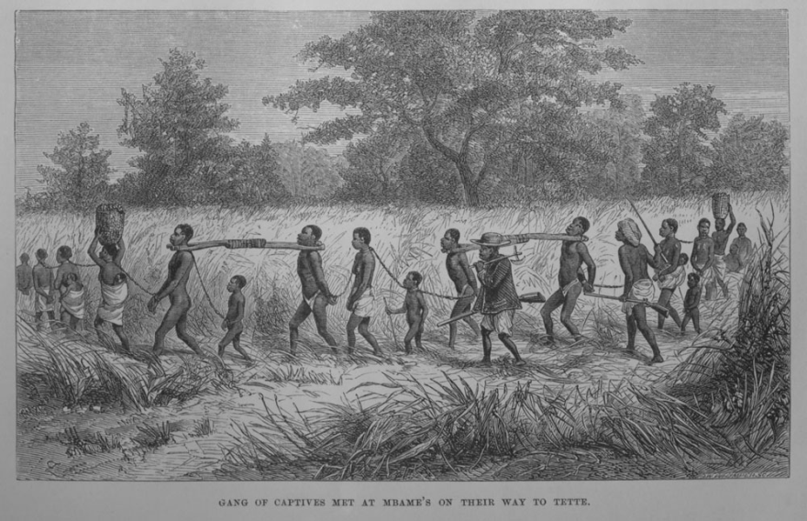
Slavery Within Africa
Europeans did not invent slavery.
In fact an active slave trade existed in Africa.
More than 25 kingdoms took part in this trade.
They sold criminals, debtors and prisoners.

Slide 19
Slavery Within Africa
The spread of Islam in Africa increased slavery as well.
The Quran (Koran), the Islamic holy book forbade enslaving Muslims but not from enslaving non-Muslims.
Arab traders began trading horses and other goods for enslaved non-Muslims.

Slide 20
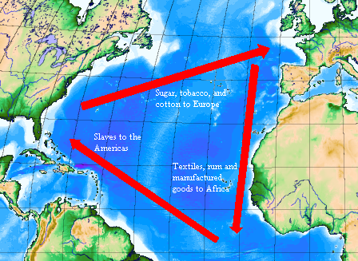
European Slave Trade
When the European’s got involved in the slave trade they did not go and capture people on their own.
Rather they dealt with caboceers-special African officials appointed by governments to exchange enslaved people with Europeans.
They met the Europeans along the coast and traded men, women and children for guns, manufactured goods, and cloth.

Slide 21
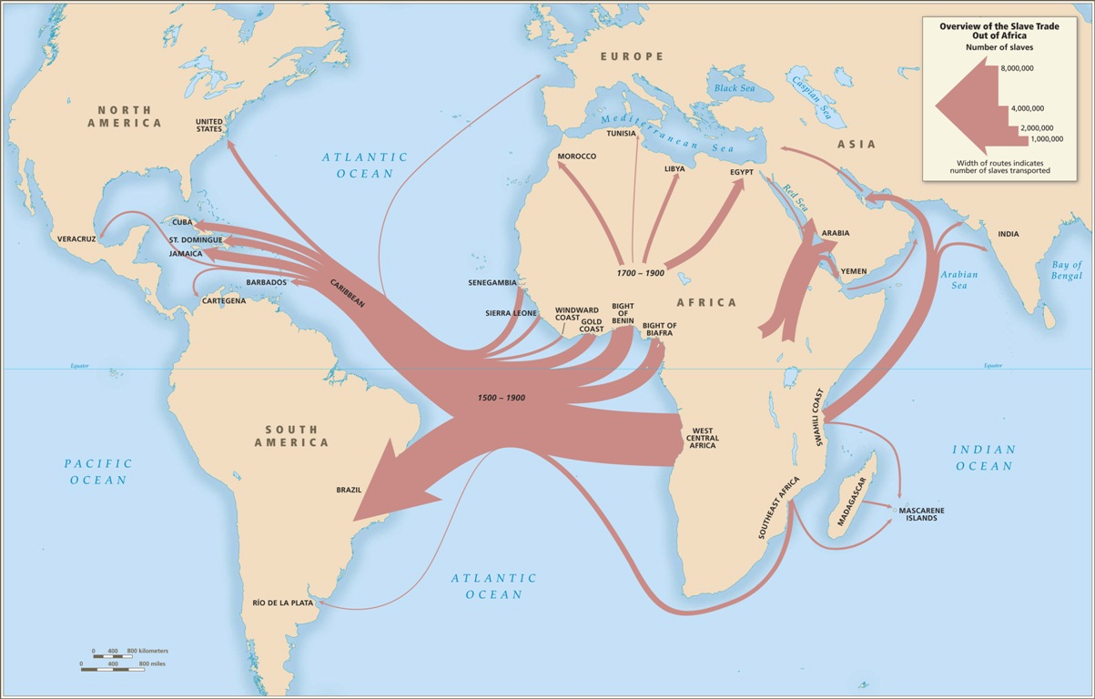
European Slave Trade
Portugal was the first country to begin trading for slaves.
They used the slaves to work on their sugar cane plantations.
By the 1500s Portugal was the world’s largest sugar producer.
The rest of Europe followed Portugal’s lead and soon all of the colonial powers would be using slave labor.

Slide 22
Triangular Trade
The trade of slaves over the next two centuries became known as the triangular trade.
The trade routes formed three legs of a triangle. 1.From Europe to Africa (traded goods for a cargo of slaves) 2. From Africa to the Americas (traded slaves for money and used money to buy goods such as molasses, sugar, tobacco, and rum), 3. From the Americas to Europe (traded the goods received in the America’s for a huge profit).

Slide 23
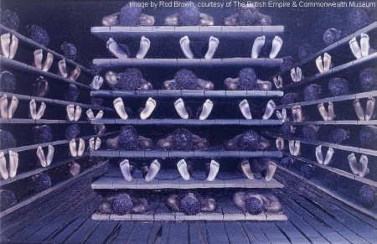
The Middle Passage
The middle part of the Triangular Trade was known as the Middle Passage.
This was the part where slaves were brought from Africa to the Americas.
They were crammed into the ships cargo hold and typically chained down.
One out of five who started the journey never made it to the Americas.

Slide 24
The Middle Passage
It is estimated that more than 11 million Africans made the journey from Africa to the Americas
The slave trade also led to what is known as racism- the unjust treatment of people by others who falsely believe their race is superior to others.

Slide 25
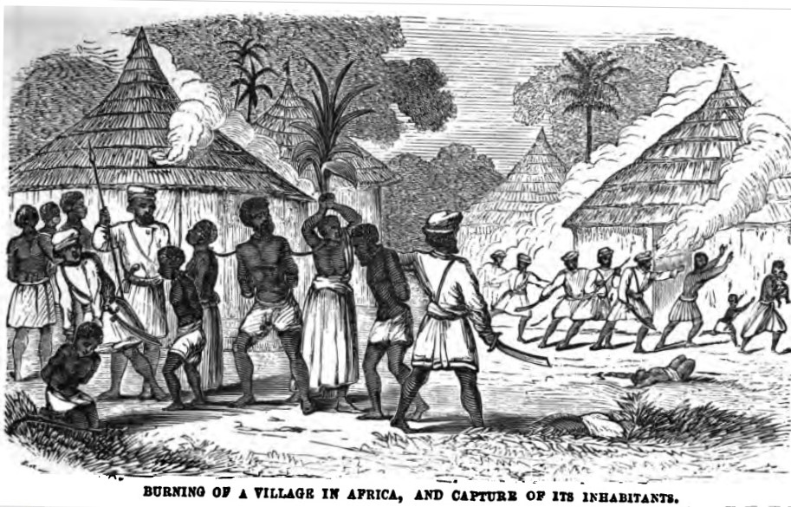
Impact of the Atlantic Slave Trade on Africa
Increase in tribal warfare
Major population decrease
Loss of workers led to dissolving of many African tribes and communities
Families were separated

Slide 26
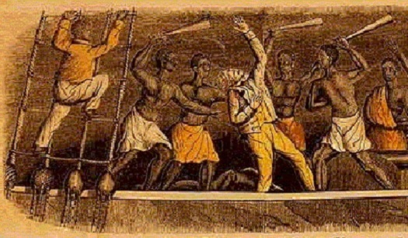
Resistance
Some Africans began to oppose the slave trade.
Attacks on slave traders increased in Africa.
In the America’s, enslaved Africans escaped and formed runaway communities known as maroons.
In 1840 and 1841 Africans led revolts aboard two slave ships, the Amistad and the Creole.

Slide 27
Trading Post Settlements
The Dutch established trading posts in Suriname (northern South America).
The French established trading posts in North America with the Native Americans and traded for furs.
The French and the Indians got along because the French did not try to convert the Native Americans to Christianity and respected the Native Americans’ right to their land.

Slide 28
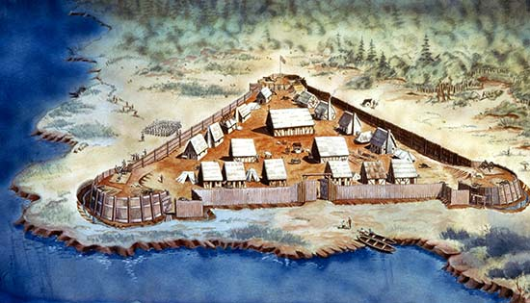
Permanent Settlements
The British establish permanent settlements along the east coast of North America.
Jamestown is the first English permanent settlement.
They bring boat loads of people to live and work in the colonies.
The British began to offend the Native Americans by:
Trying to convert them to Protestantism (Christianity).
Taking over their fur trade.
Stealing their land.

Slide 29
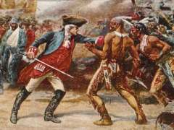
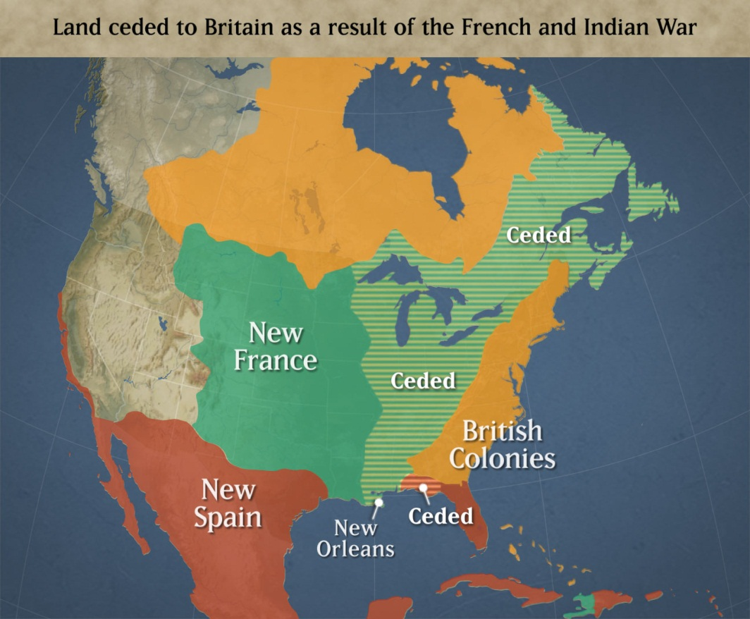
The French and Indians
The French and Indians establish a close, respectful relationship. The Indians do NOT like the British though.
The French and Indians fight against the British in the French and Indian War (or the Seven Year’s War).
The British win most of France’s land in North America, and France loses power in the Americas.

Slide 30
Summary Statement:
The Big 5 (ESPN-F) established different types of colonies in the New World:
Trading posts: France, Netherlands
Permanent settlements: England
Plantation colonies: Spain, Portugal, England, France
Europeans tried several sources of labor to work on the plantations:
Native Americans
Indentured servants
African slaves

Slide 31
European Influence in Asia

Slide 32
Building a Relationship
Asia had strong civilizations with strong militaries, in addition to highly advanced and prosperous societies.
Europeans viewed the Asians as their “equals”.
Europeans were allowed to build trading posts along the coasts of Asia.

Slide 33
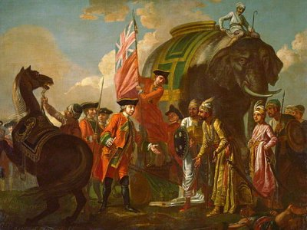
Trading
Asian countries became dependent on trading with Europeans to make money.
Asians wanted eyeglasses, firearms, and scientific instruments from the Europeans.
Trade with Europe also created a wealthy middle class.
No European colonies were built in Asia! It was all about TRADE!

Slide 34
Effects of Europeans in Asia
Prior to the Europeans’ arrival, Asian countries had remained isolationist (countries did not interact with one another).
Trade prompted the sharing of ideas and cultures between different Asian nations.
Europeans began sending Christian missionaries to Asia.
This offended many Asian governments, so eventually trade and contact with the Europeans was stopped and countries became isolationist again. (The Dutch are allowed to stay!)

Slide 35
Summary Statement:
Europeans established mutually beneficial trade relationships with the Asians as they established trading posts around the region. However, their attempts to convert Asians to Christianity resulted in the Asian nations becoming isolationist and kicking out most Europeans from the region.

