Slide 1
World War I
The Great War, The War to End All Wars

Slide 2
Causes of War: M.A.I.N.
M – Militarism: Fascination with war and a strong military
A – Alliances: Agreements among varying nations to help each other out
I – Imperialism: Building empires and competition for markets
N – Nationalism: Loyalty to a nation

Slide 3
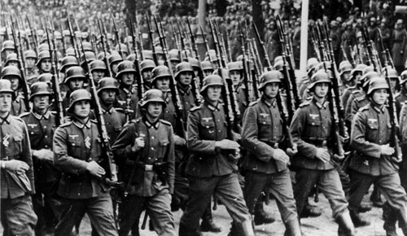
Militarism
A huge military buildup in the European countries – they were trying to intimidate each other during the time of Imperialism.
Huge armies in Germany, France, and Russia
Naval buildup in Germany and Great Britain
Many countries used “conscription” (a draft) to force citizens into the military.

Slide 4
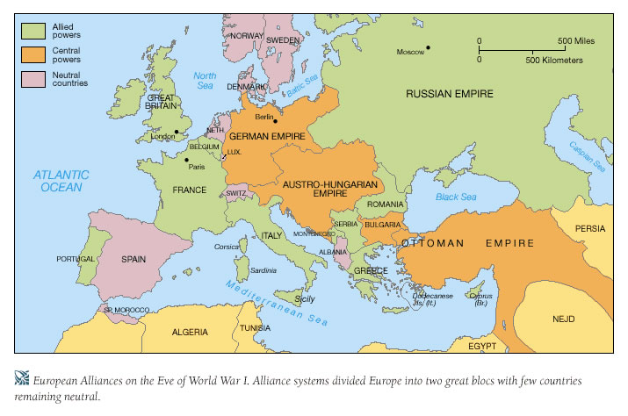
Alliances
Allies: France, Great Britain, Russia (a.k.a Triple Entente)
***(Belgium and Italy)
Central Powers: Austria-Hungary, Germany, Bulgaria, Ottoman Empire
***(Italy)

Slide 5
Imperialism
Building of empires around the world.
Needed resources and new markets for trade.
Led to huge competition, particularly in Europe!
Could there have been an earlier World War??! (The story of U.S. vs. Germany in 1888.)

Slide 6
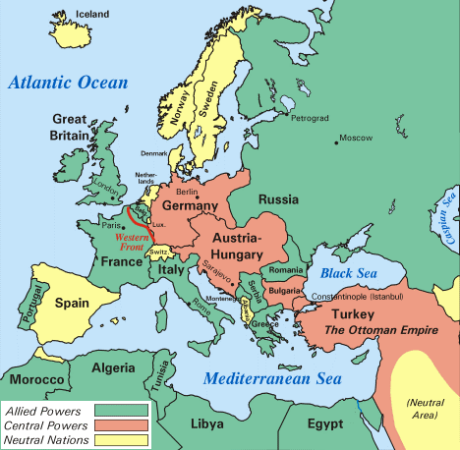
Nationalism
Nationalism: pride in one’s country
Due to imperialism, some individuals within a country’s borders felt more connected with their cultural group than with the larger nation.
Led to bitterness among some European people/regions (ex. Serbia and the Slavs on the Balkan Peninsula)

Slide 7
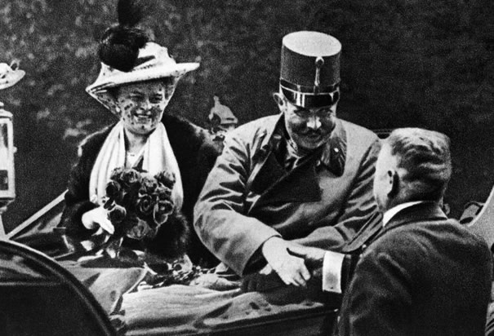
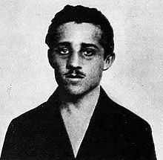
“The Powder Keg” Ignites!
The Black Hand was a Serbian Nationalist group committed to liberating all Serbians from Austro-Hungarian control.
Gavrilo Princip (19 years old) assassinates Archduke Franz Ferdinand (heir to the throne in A-H) and his wife on a trip to Sarajevo, Bosnia.
Austria-Hungary declares war on Serbia!

Slide 8
Austria-Hungary declares war on Serbia
Russia mobilizes to support Serbia
Germany mobilizes to fight Russia
France declares war in support of Russia
Great Britain declares war on Germany after Belgium is invaded

Slide 9
War Begins
Three front (line where opposing sides fight each other) war: Eastern Front on the Russian border (Germany vs. Russia/Serbia), Western Front in Belgium and France (Germany vs. France/Great Britain), and the Italian Front (Italy and France vs. Austria-Hungary and Germany
Western Front used trench warfare (fighting in ditches)
Trenches stretched from the English Channel to Switzerland

Slide 10
Modern Weapons
Factories were mass producing weapons for the war.
Increased deaths and casuality rates for soldiers and civilians:
 | Mobilized | Killed/ Died | Wounded | Prisoners/Missing | % of casualties
Allies | 42,188,810 | 5,152,115 | 12,831,004 | 4,121,090 | 52%
Central Powers | 22,850,000 | 3,386,200 | 8,388,448 | 3,629,829 | 67%
Total | 65,038,810 | 8,538,315 | 21,219,452 | 7,750,919 | 57%

Slide 11
Modern Weapons
Weapon | Impact
Airplanes | First time in war. Used mostly for spying on enemy troops. Eventually carried bombs and guns to fire on troops.
Submarines | Fired on enemy navy ships and merchant vessels. German subs called U-boats.
Machine guns | Took 4-6 men to operate. Could fire 400 bullets a minute (= to 100 guns).
Long-range artillery | Took up to 12 men to operate. Could shoot up to 75 miles away. Terrorized troops well behind fighting lines
Tanks | Used toward the end of the war. Could roll through barbed wire. Provided protection for attacking soldiers
Flamethrower | Shot fire at troops and into foxholes
Poison gas | Chlorine gas: Suffocates a person, Mustard gas: burns/blisters any exposed skin

Slide 12
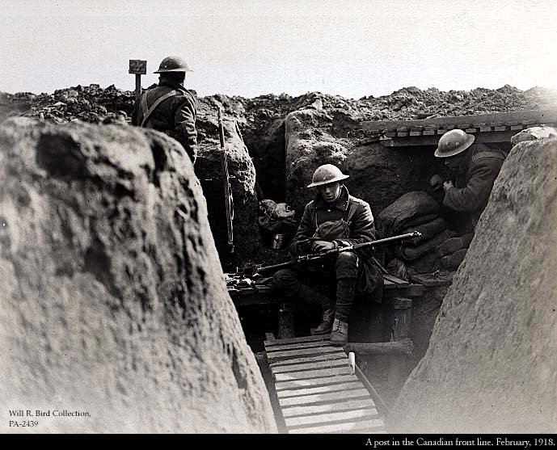
Trench and foxhole

Slide 13
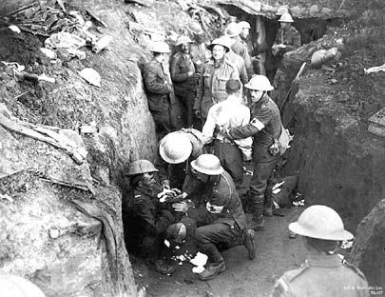
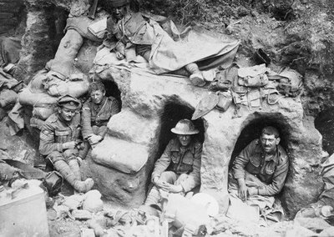
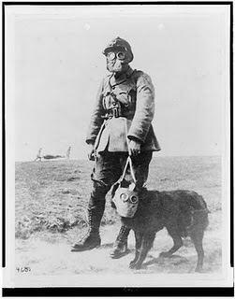
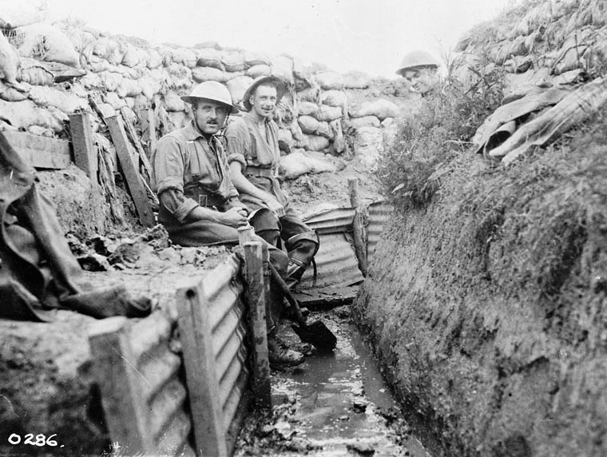

Slide 14
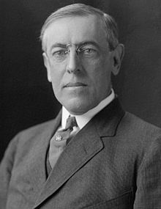
U.S. Entry
President Woodrow Wilson wanted to remain neutral. (Isolationist)
At first, we traded and made loans to both Allies and Central Powers.
U.S. supported a British blockade of Germany (stopped all imports)
Germans retaliated with U-boats.

Slide 15
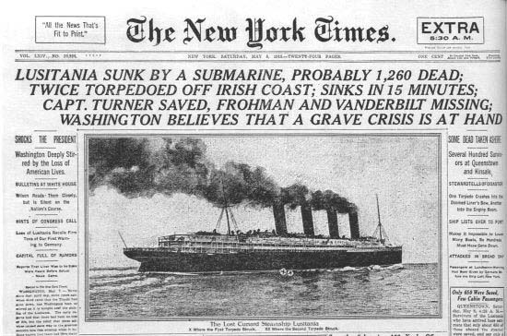
U.S. Entry
In 1915, Germany fired on the British passenger ship, the Lusitania.
1,200 people died, including 128 Americans.
Americans are angry, but Wilson won’t enter war.

Slide 16
U.S. Entry
1916: Germans promise to give warning to U.S. boats before sinking them
January 1917: Zimmermann Telegram discovered. German official sends telegram to German ambassador in Mexico. If Mexico becomes allies with the Central Powers and attacks the U.S., they would win back land in the southwest United States once the war was over.
February 1917: Germany starts sinking U.S. ships without warning

Slide 17
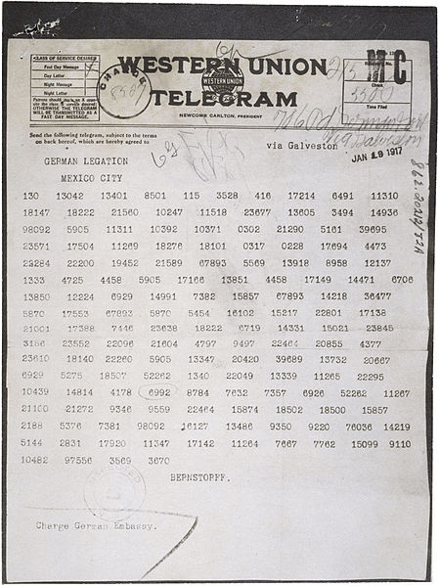
Zimmermann Telegram

Slide 18
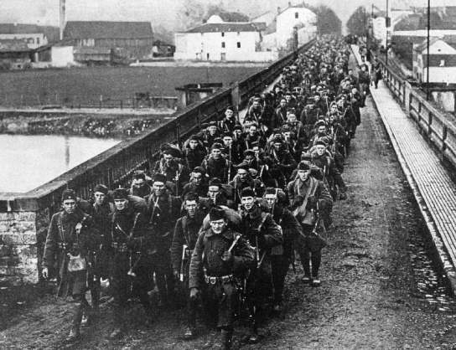
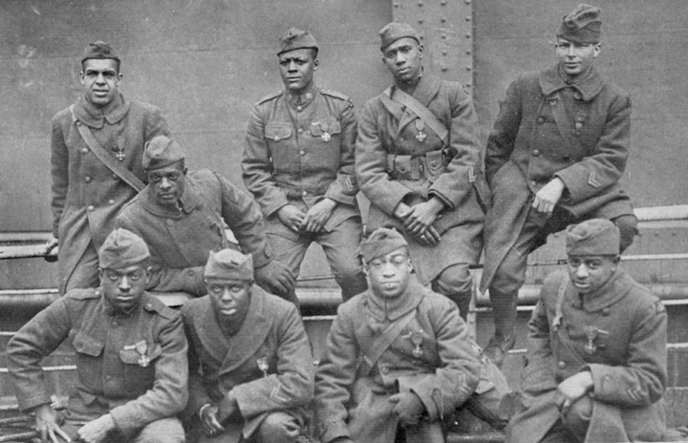
U.S. Entry
U.S. declares war April 6, 1917.
First soldiers, “doughboys” arrive in France in June 1917.
Selective Service Act is passed to increase the size of the U.S. military
May 1918: over 1,000,000 U.S. soldiers in France

Slide 19
Russian Revolution
By 1917, Russia is in crisis:
Lack of food and fuel for peasants and workers
Lost millions of men in WWI
High taxes
Poor working conditions
March 1917 workers rebel (led by women), soldiers join them
Czar Nicolas II (Romanov dynasty) abdicated (March 1917)

Slide 20
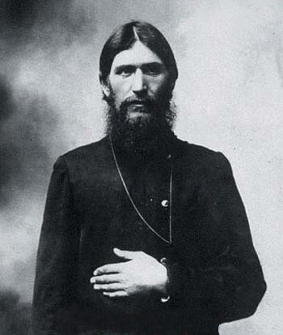
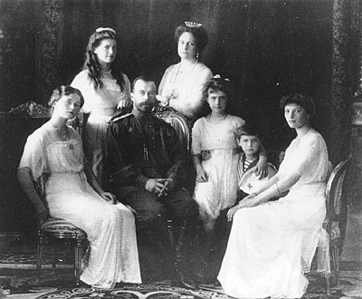
Rasputin and the Romanov family

Slide 21
Russian Revolution
Temporary govt (Duma) is set up. They are pre-occupied with the war.
Workers formed “soviets” to represent their interests. Many were socialists: everyone should share equally in the nation’s wealth.
The most radical of the soviets were the Bolsheviks.

Slide 22
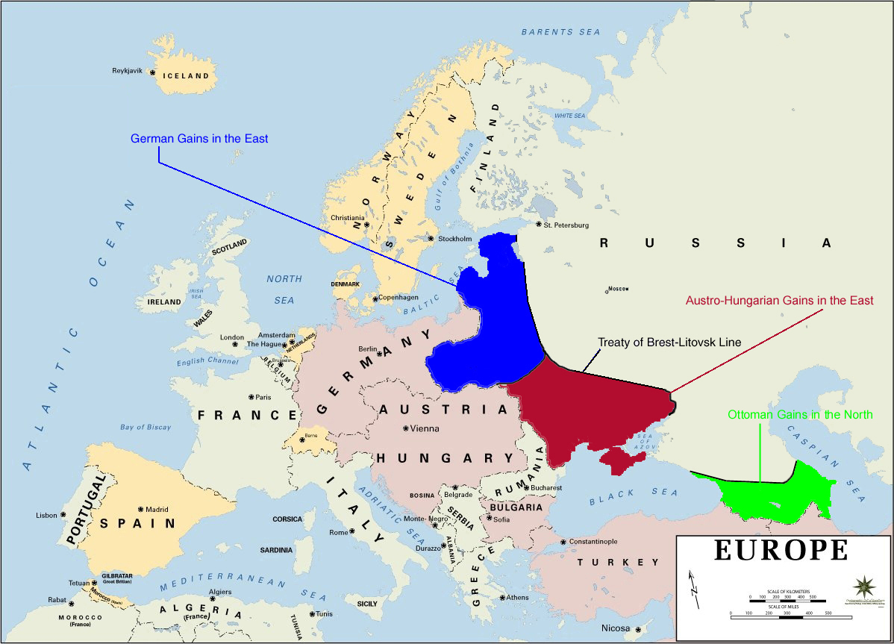
Russia Out of WW1
Vladimir Lenin is the leader of the Bolsheviks (Communists).
Promised to take Russia out of war. A cease-fire is arranged in December 1917.
Russia signed the Treaty of Brest-Litovsk with Germany March 1918. The Russians are forced to give up land to Germany, including land in Poland.

Slide 23
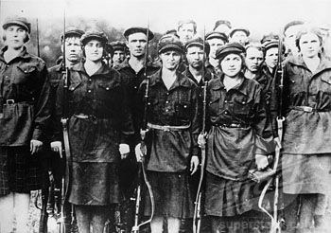
Russian Civil War
Bolsheviks (Reds) took control by force.
All opposed to Bolsheviks and/or supporters of the Czar (Whites).
Russian Civil War begins.
Last for 3 years – killed civilians and burned villages.
Reds win in 1921, Russia becomes known as the Union of Soviet Socialist Republics (USSR) – Communist.

Slide 24
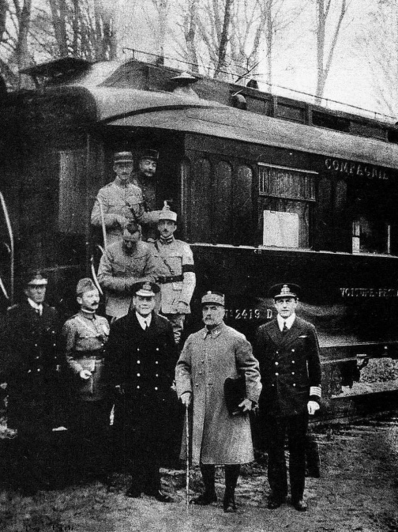
The End…
Battle of Argonne- U.S. forces shatter the German army.
Central Powers are thrown into chaos.
Germany signed an armistice, cease-fire, November 11, 1918.

Slide 25
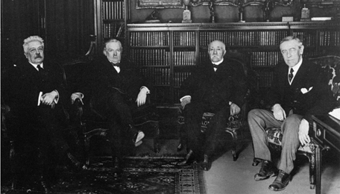
The Big Four
Meet in Paris to decide the terms of the peace treaty (January 1919).
President Woodrow Wilson (U.S.)
Prime Minister David Lloyd George (Great Britain)
Premier Georges Clemencaeu (France)
Prime Minister Vittorio Orlando (Italy)

Slide 26
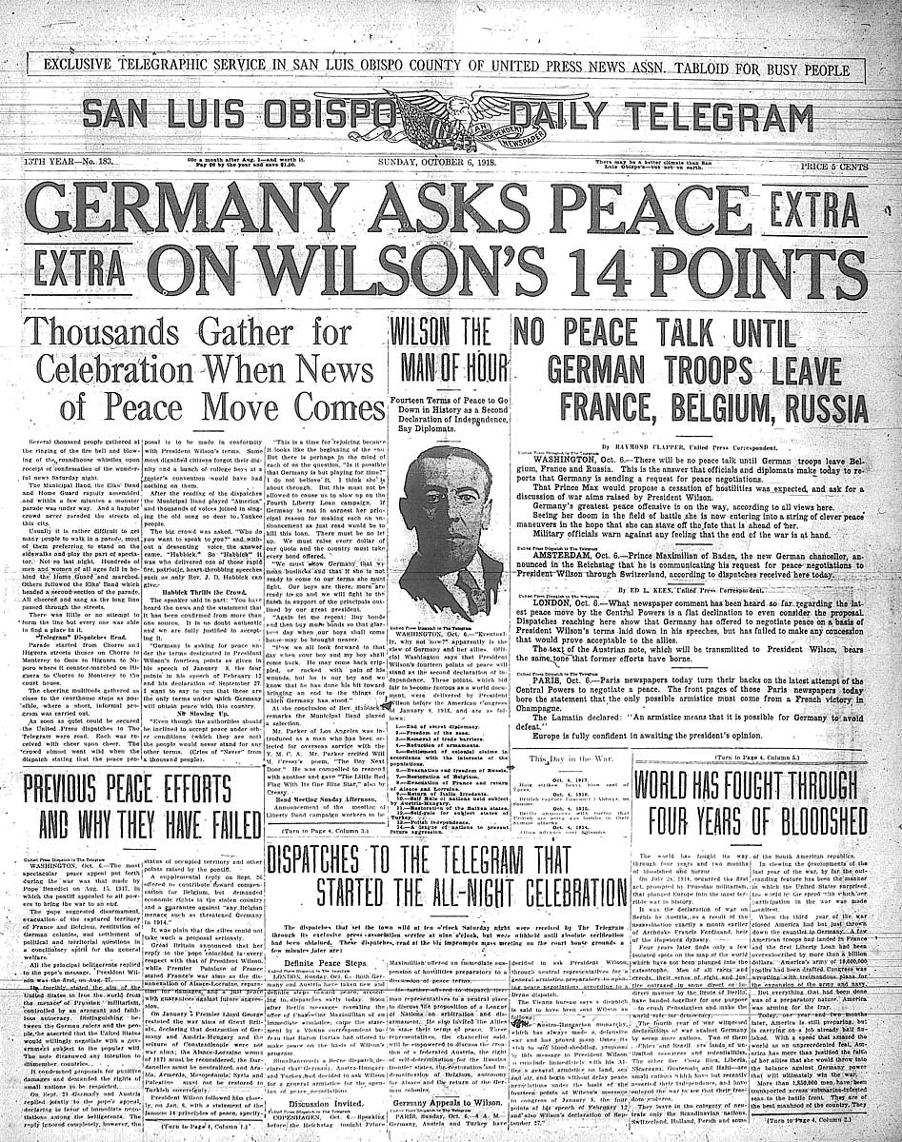
Wilson’s Fourteen Points
Wanted a lasting peace and reasonable terms.
His Fourteen Point proposal included ideas to undo the M.A.I.N. causes of WW1 (no military build-ups, no secret alliances, the right to self-determination (a country could determine its own political and economic systems).
Didn’t want to “punish” the Central Powers.
The only part of Wilson’s plan to be adopted was the League of Nations – a peacekeeping organization of countries set up to deter future conflicts.

Slide 27
Treaty of Versailles
Wilson’s Fourteen Points focused on fixing the causes of WW1, while the Great Britain and France focused on weakening Germany and improving their status in the world.
Treaty of Versailles was structured to punish Germany.
Signed in 1919.
Because the treaty focused on revenge, it will lead to financial and political instability in Europe after the war.

Slide 28
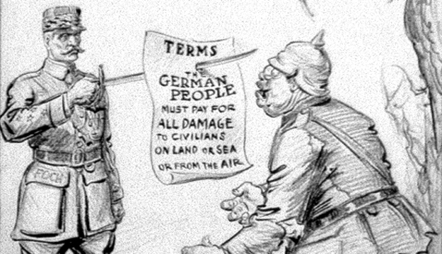
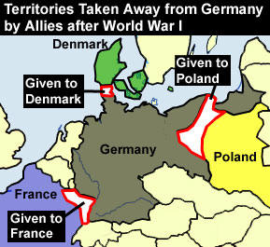
Punishment Clauses
“War Guilt Clause” - Germany must accept responsibility for starting the war.
Pay reparations (war damages). Reparations totaled $33 billion ($402 billion today)
Limited the army to 100,000 soldiers
No air-force or submarines
Demilitarization of the Rhineland
Loss of Alsace-Lorraine territory (area bordering France and Germany) and all overseas territories.

Slide 29
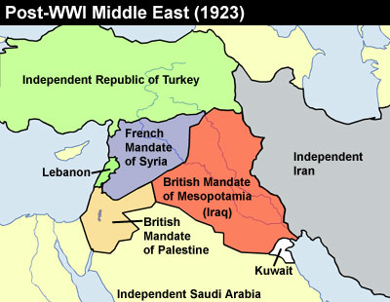
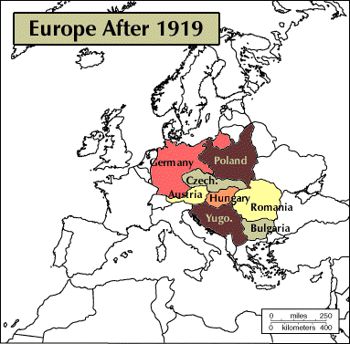
Changes of Territory
German, Austria-Hungarian, and Ottoman Empires are divided up to create new countries in Eastern Europe and the Middle East. The nation of Yugoslavia is created in the Balkans that included many nationalist groups, including Serbia.

Slide 30
Ottoman Empire After War
The Treaty of Versailles broke up the Ottoman Empire, created mandates (territory controlled by another country)
France controlled Lebanon and Syria
Britain controlled Iraq, Jordan, and Palestine.
Balfour Declaration - The British promise the Jews a new nation of their own in Palestine (the area of the Jewish homeland during Biblical times)…the problem is there are Arab people who have been living there for many centuries!!!

Slide 31
Problems with the League of Nations
Not all major powers joined the League. (ex. U.S. didn’t join (afraid it would force the U.S. to fight future wars), Russia and Germany not allowed)
Had no real authority to enforce its ideas
Required unanimous decisions to do anything

