Slide 1
The Scientific Revolution
Standards 7-2.2

Slide 2
Vocabulary: Scientific Revolution
Revolution – a sweeping change
Geocentric – earth-centered universe
Astronomer – scientist who studies the motion of stars and planets
Heliocentric – sun-centered universe
Excommunication – exiled, or thrown out of the (Catholic) church
Heresy – anti-Church teachings
Scientific Method – a systematic way to find proof using reason: includes a question, forming a hypothesis, testing the hypothesis, and reaching a conclusion
Rationalism – knowledge is based on reason (thinking)

Slide 3
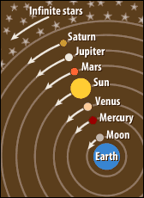
Old school ideas
During the Middle Ages (until the 1500’s), scientific ideas came from:
The writings of ancient Greece and Rome
The teachings of the Catholic church
Believed the earth was the center of the universe (geocentric) - Ptolemy

Slide 4
Changing ideas
Beginning in the 1500’s
Explorers are mapping the Earth
Translate the work of Arab scientists
Hindu-Arabic number system spread to Europe
Astronomers invented better tools for studying space

Slide 5
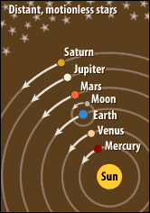
New Ideas about the Universe
Copernicus (Poland)
Sun centered universe (heliocentric) – planets revolve around the sun, moon revolves around Earth
Worked in secret because he feared excommunication by the Catholic Church
Published his ideas in 1543

Slide 6
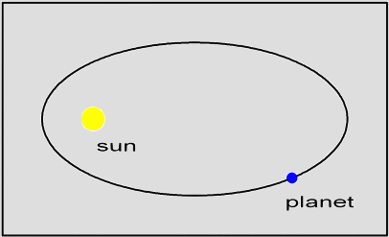
New Ideas about the Universe
Kepler – (Germany)
Used math to show that planets moved in ellipses (oval orbits) not circles
Planets moved faster when they got close to the sun
Protestant so he didn’t fear the church

Slide 7
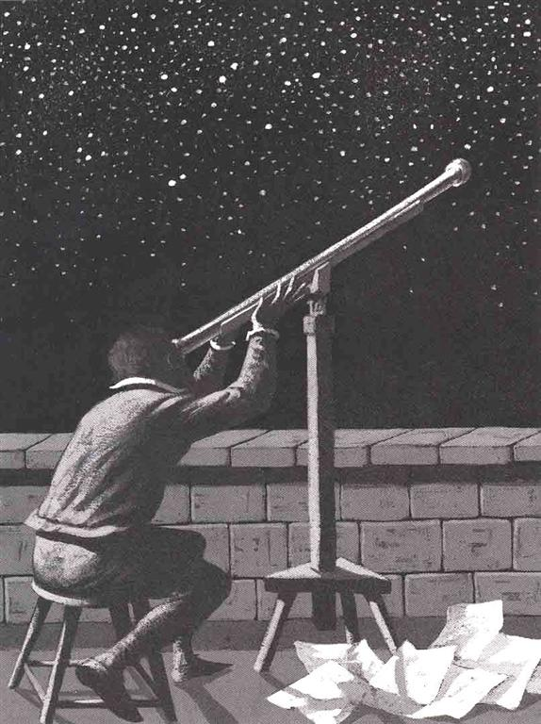
New Ideas about the Universe
Galileo – (Italy)
Built improved telescope, clock, and water thermometer
Discovered:
Mountains on the moon
Spots on the sun
Four moons of Jupiter
Evidence of Sun-centered Universe
In 1532, charged with heresy (anti-Church teachings)
Lived under house arrest

Slide 8
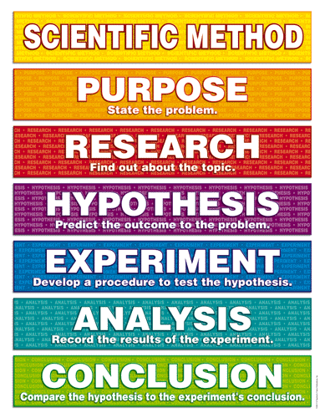
New Ways of Thinking
Francis Bacon – (England)
Thought you should throw out everything that hadn’t been tested
Came up with the Scientific Method

Slide 9
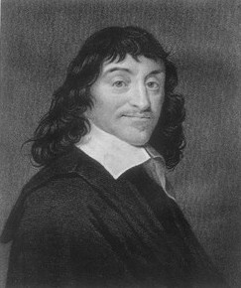
New Ways of Thinking
Rene Descartes – (French)
“I think, therefore I am.”
Used math to prove scientific facts
Founder of modern rationalism – all knowledge is based on reason.

Slide 10
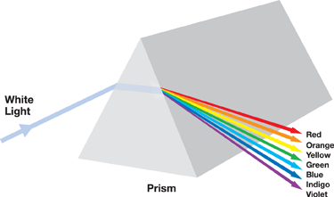
Newton’s Universe
(1642-1727)
White light is made of different colors (rainbow)
Invented calculus (type of math)
Theory of the Law of Gravity – force of gravity holds the entire solar system together and keeps the planets in their orbits
What goes up must come down

Slide 11
The Catholic Church and Science
The Catholic Church served as the authority for politics and society.
The viewed the Bible as the sole source of information.
The Catholic Church viewed the new scientific research as a threat to their power.
The challenges to authority through science and reasoning encouraged a group of philosophers to question and challenge government authority. This is known as the Enlightenment, and leads to numerous revolutions that end absolute monarchies.

