Slide 1
The French Revolution
Standard 7-3.1

Slide 2
Vocabulary
Tyranny – unjust use of power
Estates – social classes in France
Aristocracy – nobles
Bourgeoisie – middle class
National Assembly – a government consisting of delegates from the Third Estate
Declaration of Rights of Man and of the Citizen – a document that stated that government got its power from the people, not the king. It also stated basic freedoms for citizens.
Radicals – people who favor quick and far-reaching changes

Slide 3
Reign of Terror – a period of time when anyone suspected of being disloyal to the revolution or favor the return of the king was killed
Directory – A five-person council set up to run the government
Coup d'état – a swift seizure of government, or a military overthrow of the government
Napoleonic Code – A new legal system in France created by Napoleon to give people rights. It is based on ideas of the Enlightenment philosophers.

Slide 4
Influences of the American Revolution
Colonists, borrowing ideas from Enlightenment thinkers, decided to rebel against the British government.
They protested:
Colonial governments (put in place by the English King)
“No taxation without representation”
Defended the right to assemble
Wrote the Declaration of Independence in 1776
French nobles were inspired and volunteered to fight (ex. The Marquis de Lafayette)

Slide 5
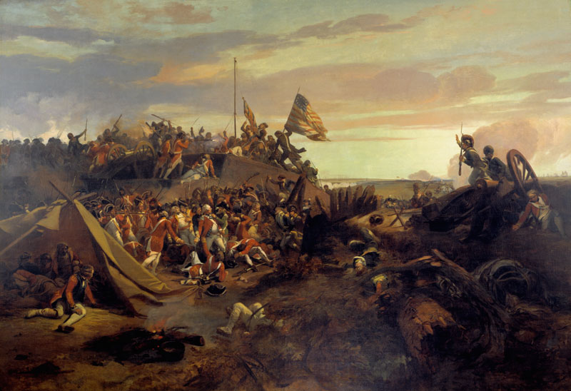
France and the American Revolution
King Louis XVI agreed to help the colonists in order to get back at the British for winning the Seven Years War (The French and Indian War) in the colonies.
France sent 12,000 soldiers and 32,000 sailors to help the colonists in the war.
French warships help force the British surrender at Yorktown.

Slide 6
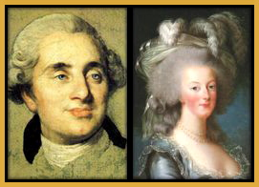
The American Revolution inspired the French to fight Tyranny (unjust use of power)!!!

Slide 7
Causes of the French Revolution
Unfair Social Divisions (The Three Estates):
First Estate (Clergy – Church Officials) 1% of the population, own 15% of land – pay no taxes
Second Estate (aristocracy – nobles) 2% of population, own 25% of land – pay no taxes
Third Estate – divided into two groups – the bourgeoisie (middle class) and the peasants (80% of the population) – owned 60% of land, paid all of the taxes

Slide 8
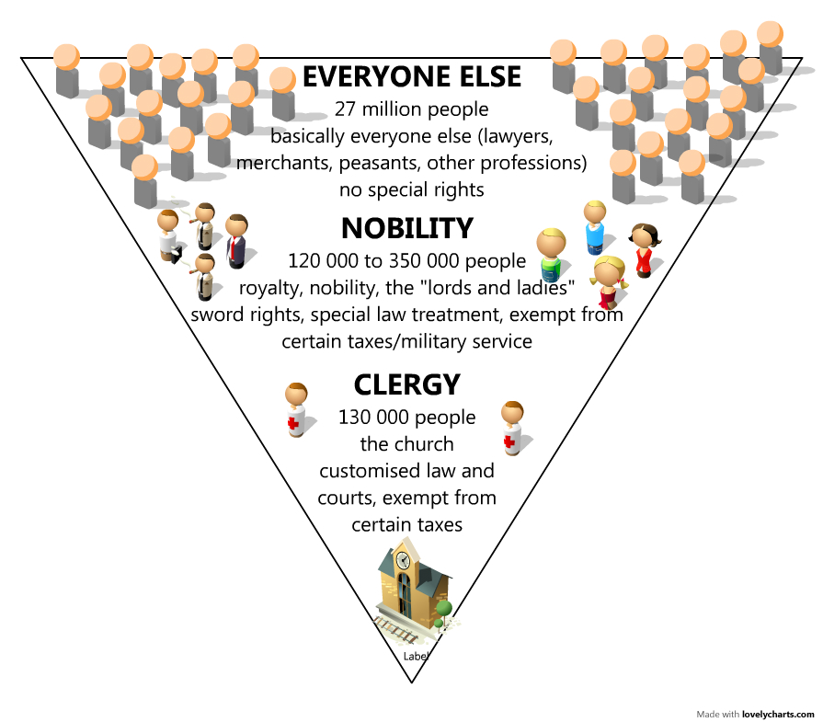

Slide 9
Causes of the French Revolution
Unfair tax system – the Third Estate paid all of the taxes
Government debt
From wars against England and the luxurious lifestyle of the monarchy
Banks refused to lend the king more money
Prices of the cost of living were going up
Bread, a staple in the French diet, costs over half of an individual’s salary
Poor wheat crops cause bread prices to soar
Bread riots

Slide 10
Calling the Estates Together
King calls for the Estates-General to meet in 1789.
First and Second Estate refuse to pay taxes.
Each Estate had one vote. The first and second estate would always vote together and create a 2-1 vote over the third estate. The third estate wants for every male citizen to have the right to vote.
Third Estate gets locked out of the meeting – meet on a nearby Tennis Court:
Tennis Court Oath – promise to make a new constitution
Third Estate became the National Assembly

Slide 11
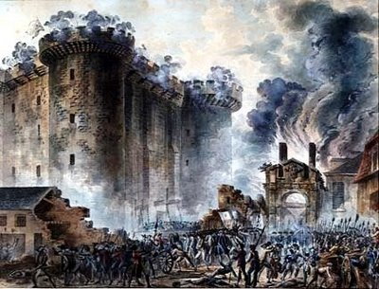
Fall of the bastille
King Louis XVI began gathering troops.
Revolution began – people stormed the Bastille (French prison)to get gunpowder.
Riots break out around the countryside and peasants began attacking the homes of the nobles.
National Assembly adopts the “Declaration of Rights of Man and of the Citizen.” (Written by Marquis de Lafayette)
Stated basic freedoms
Government gets power from
the people not the king
Made France a Constitutional
Monarchy (1791)
Liberty, Equality, Fraternity!

Slide 12
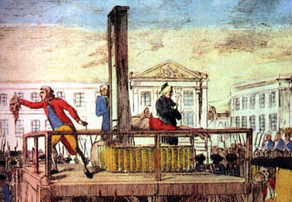
Struggle for Power
National Assembly declares war on Austria and Prussia (hoping to unify the French people).
France loses – radicals take over the government and named it the National Convention
The radicals (Mountain) put the king on trial and behead him in January 1793.
Another war in 1793 – all the European countries declare war on France to stop the spread of revolution.

Slide 13
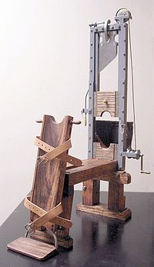
Reign of Terror
Committee of Public Safety formed to keep people from protesting the revolution.
Headed by Maximilien Robespierre.
Used the guillotine to execute anyone that disagreed with the revolution: friends of the monarchy, members of the 1st and 2nd estates, some peasants
Estimated 40,000 killed by the Guillotine (includes Marie Antoinette)

Slide 14
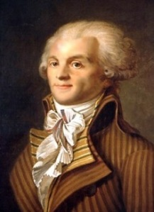
End of the REvolution
Reign of Terror ends with the beheading of Robespierre.
Five person council (Directory) set up to run the country – very weak.

Slide 15
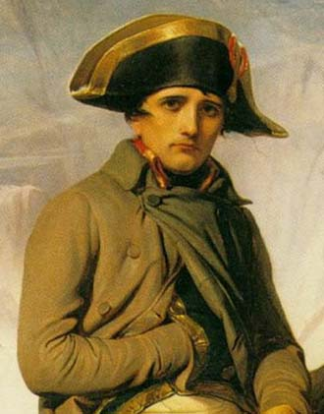
Napoleon Bonaparte
Popular army general takes power in coup d’etat (1799)
Names himself Emperor of France (1804)
Created a new legal system based on the Enlightenment
Restored the Catholic Church, but reduced its the power
Increased rights and equality of French people
Conquers most of Europe
Set up a national banking system
Ended government corruption

Slide 16
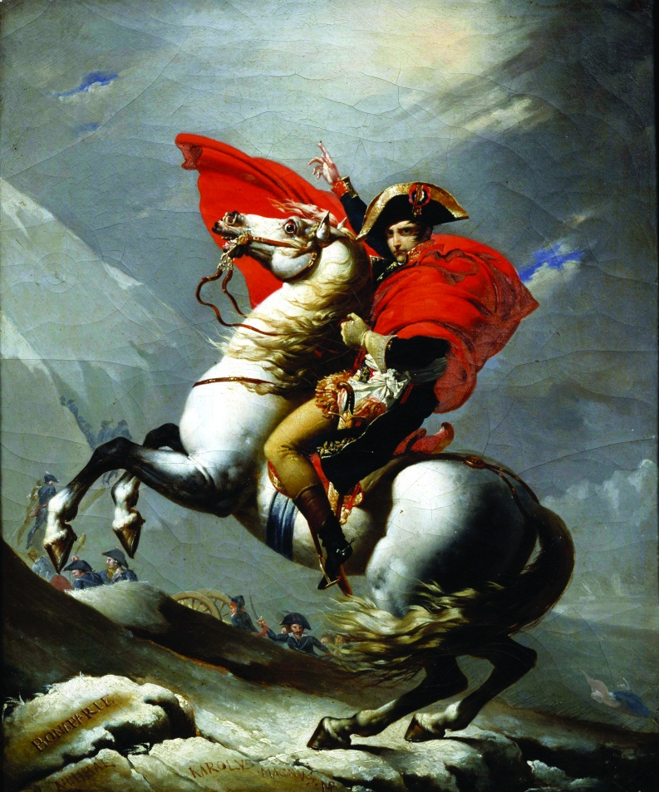
Napoleon
Napoleonic Wars – Napoleon began invading and conquering all of the countries to the east and west of France in Europe.
By 1812, all of Europe is conquered except for Great Britain and Russia.
Legacy = Nationalism

Slide 17
Nationalism
Nationalism is the pride in one’s country based on shared customs and common history.
American and French Revolutions inspired loyalty to a country rather than a leader
Encouraged independence in L.A.
Encouraged unification in Europe

Slide 18
Napoleon’s Empire
Pros
Cons
Legal equality for citizens
Tolerance for religious freedom
Right to earn a living
Had to pay taxes to France
Required to send soldiers to Napoleon’s army
Had to swear loyalty to Napoleon and France

Slide 19
Napoleon’s Downfall
Beginning in 1812, Napoleon made three mistakes:
Tried to invade Russia…in winter – failed miserably.
Tried to block all European trade with the British.
Lost the Peninsular War with Spain.
In 1814, Napoleon surrenders the throne and is exiled to Elba.
He escapes, gathers supporters in the Hundred Days, attacked the British to regain power. The British capture him and exile him to St. Helena.

