Slide 1
The cold War Begins

Slide 2
World Superpowers
After WW2, the U.S. and the Soviet Union emerge as the leaders of the world.
The U.S. wants to spread democracy (people choose their leaders in government) and free enterprise (businesses compete for profits with little government control). The Soviet Union wants to spread communism (the government controls every aspect of life).
The U.S. wants to stop the spread of communism!!!
The differences between the two countries begin the COLD WAR.

Slide 3
The Cold War
A “hot war” is a war with real military combat. The “Cold War” was a competition between the U.S. and the U.S.S.R. to build up the biggest supply of weapons, in addition to helping the economy and military of weak nations in order to get their support.

Slide 4
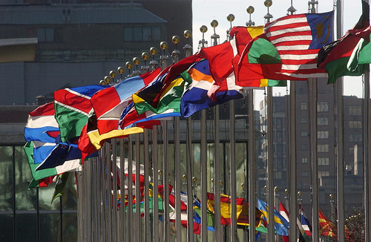
Creation of the United Nations
Created in 1945 after WW2 as a global peace-keeping organization (takes the place of the League of Nations).
Consists of two main groups: the General Assembly and the Security Council. The General Assembly discusses and votes on issues (including poverty and human rights topics). The Security Council votes on the use of military force and sanctions (penalties) against a country.
The Security Council has five permanent members (France, Soviet Union, the United States, China, and the United Kingdom) and 10 elected members. The Soviet Union and the U.S. often blocked each other’s votes.

Slide 5
How the Cold War Began
After the war ends, the Soviet Union refuses to remove the troops that had been used to kick out the Germans from countries in Eastern Europe. (ex. Poland, Hungary, Romania, Yugoslavia, Albania, Bulgaria, Czechoslovakia).
These countries become “satellite” countries of the USSR – meaning they were clustered around the Soviet Union and the Soviets controlled their governments and economies.

Slide 6
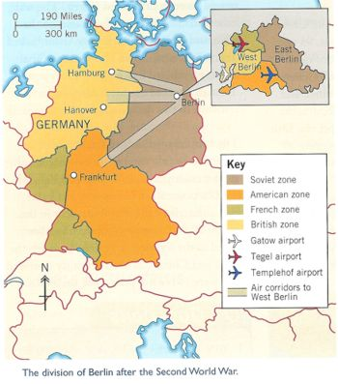
How the Cold War Began
Yalta Conference (1945) ended WW2. The “Big Three” meet there (Roosevelt, Stalin, and Churchill) to determine what should happen with Germany.
(Germany is divided into 4 zones: French, British, and American zones (becomes democratic West Germany in1949), and the Soviet Union’s zone (becomes communist East Germany).
Berlin (the former capital) was also divided into zones.

Slide 7
Containment of Communism
Truman Doctrine (1947)– Promises to stop the spread of communism worldwide. The U.S. pledges money to help individuals fight communism worldwide.
Marshall Plan (1947) – U.S. gives $13 billion dollars to help Western Europe after the war because Communism was more likely to spread in places with poverty.

Slide 8
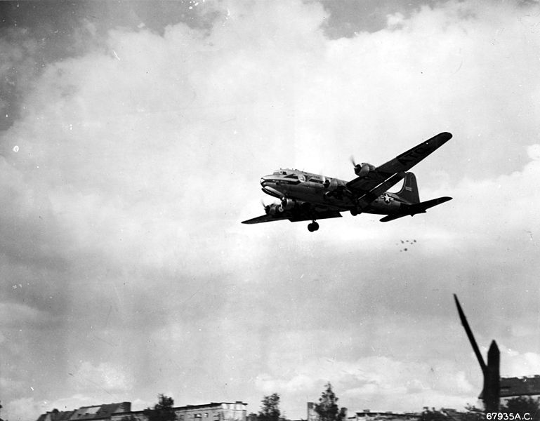
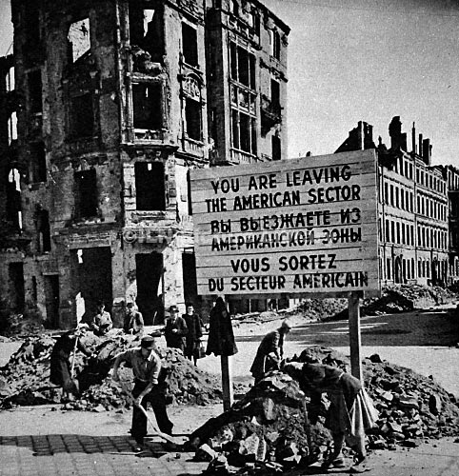
Berlin (1948)
Although ½ of Berlin is controlled by Americans, French, and British, the city is located deep into Soviet territory.
Soviet Union creates a blockade of West Berlin, not allowing the Allies to bring food and other supplies to their sector of the city.
Berlin Airlift was an 11 month period when Allies had to drop supplies from airplanes into the democratic sectors of Berlin.
Created lots of tension between the U.S. and U.S.S.R.

Slide 9
New Alliances
NATO (North Atlantic Treaty Organization – 1949): military alliance among the U.S., Canada, and 10 European countries (democratic countries)
Warsaw Pact (1949): military alliance between the Soviet Union and other communist countries
EEC (European Economic Community): alliance of countries who wanted to allow free trade among themselves

