Slide 1
Technology and Exploration
Standard 7-1.2

Slide 2
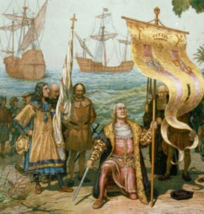
Improvements
European nations were able to economically, politically, and militarily dominate the world during the 1600’s and 1700’s due to improvements in the following:
Mapmaking
Improved navigational tools

Slide 3
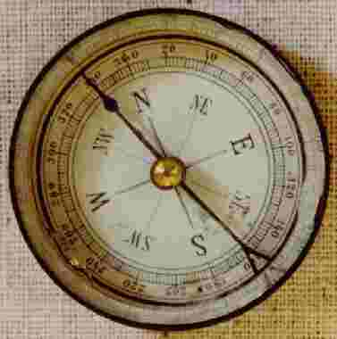
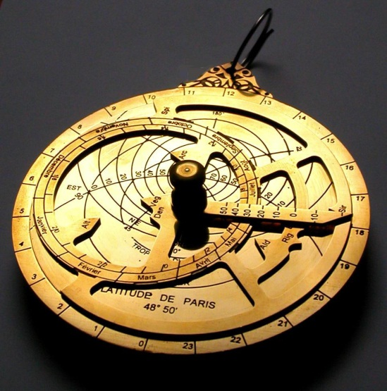
Navigational Tools
Astrolabe
Compass
Allowed sailors to use the position of the sun and stars to determine latitude.
Invented by the Greeks, but advanced by the Arabs.
Uses a magnetized needle to determine direction.

Slide 4
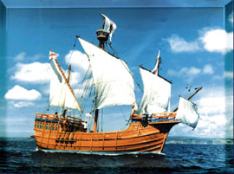
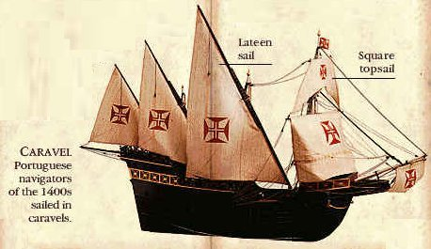
Navigational Tools
Caravel
A smaller, lighter boat that was designed to sail in shallow waters close to shore.
Flat hull (bottom of the boat) allowed for more cargo space.
Triangular sails allowed the ship to sail into the wind (tacking).
Made voyages much faster.

Slide 5
Navigational Tools
Rudder
A flat, moveable piece at the back of the ship that made it easier to steer.
This helped boats get away from pirates and other threats faster.

Slide 6
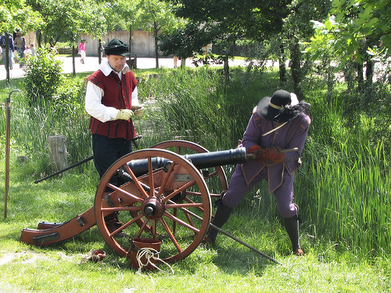
Gunpowder
Gunpowder was created in 900 A.D. by the Chinese.
The Europeans learned about it from the Arabs during the Crusades in the 1200s.
European scientists developed new rifles and cannons.
This allowed Europeans to easily dominate the land and people in the newly claimed lands because the natives did not have guns.

Slide 7
These advances helped Europeans to spread their political systems, economic models, and cultural beliefs (religion) and dominate the world.

Slide 8
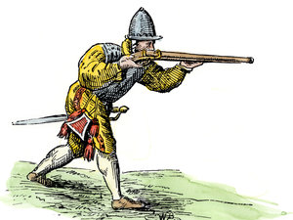
Summary Statement about Technology
Scientific and technological advancements allowed Europeans to dominate natives of the Americas in the 1600’s and 1700’s.

