Slide 1
The Growth of European Nationalism
Standard 7-3.6

Slide 2
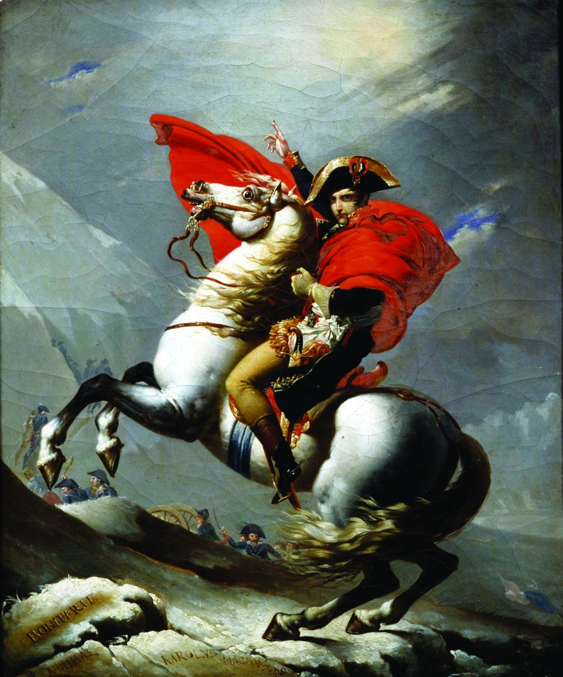
Napoleon
Napoleonic Wars – Napoleon began invading and conquering all of the countries to the east and west of France in Europe.
By 1812, all of Europe is conquered except for Great Britain and Russia.
Legacy = Nationalism

Slide 3
Nationalism
Nationalism is the pride in one’s country based on shared customs and common history.
American and French Revolutions inspired loyalty to a country rather than a leader
Encouraged independence in L.A.
Encouraged unification in Europe

Slide 4
Napoleon’s Empire
Pros
Cons
Legal equality for citizens
Tolerance for religious freedom
Right to earn a living
Had to pay taxes to France
Required to send soldiers to Napoleon’s army
Had to swear loyalty to Napoleon and France

Slide 5
Napoleon’s Downfall
Beginning in 1812, Napoleon made three mistakes:
Tried to invade Russia…in winter – failed miserably.
Tried to block all European trade with the British.
Lost the Peninsular War with Spain.
In 1814, Napoleon surrenders the throne and is exiled to Elba.
He escapes, gathers supporters in the Hundred Days, attacked the British to regain power. The British capture him and exile him to St. Helena.

Slide 6
Congress of Vienna
The Congress of Vienna was a meeting of the European countries where:
All lands taken by Napoleon were returned to the nation’s which they originally belonged.
Reinstated the absolute monarchs of Europe back to the throne to stabilize Europe.
People wanted a change in government though, so it led to two things:
Unification (people of common culture from different states were joined together)
Separation (groups split from their current government to form one that reflected their own interests)

Slide 7
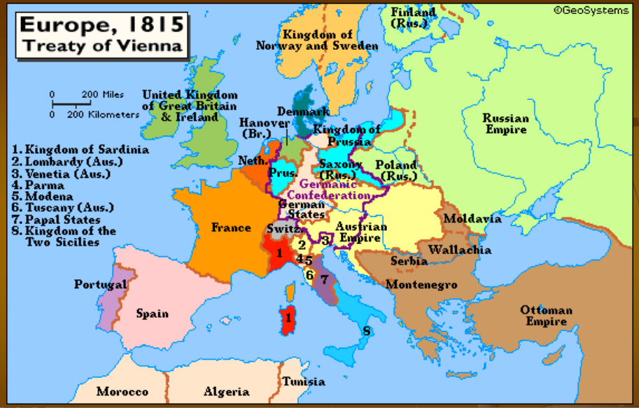
Congress of Vienna

Slide 8
Nationalist Movements
1830’s
1848
Greece gets independence from the Ottoman Empire (1st nationalist movement in Europe).
Belgium, Italy, and Russia attempt rebellions.
Italy begins unification.
France overthrows the monarchy and establishes a republic: elected a president and established a parliamentary system (elected representatives).

Slide 9
Italy
1848- Italy divided into States, most controlled by Austria
In Northern Italy, Piedmont was independent
King Emmanuel and Prime Minister Cavour want to unite Italy
France helped Piedmont get freedom for the northern Italian states
Guiseppe Garibaldi (leader of the Red Shirts) used guerilla warfare (hit and run fighting) in southern Italy.
1861, the south votes to join the north – Italy is unified, except for Rome (controlled by the pope)
1870, Rome joins Italy.

Slide 10
Germany
1815- Germany made of 40 states
1860’s – Many Germans want to unite
Prussia is the largest and strongest military state
King Wilhelm 1 appointed Otto von Bismark as Prime Minister – goal to strengthen the military
Bismark ruled under a system called “realpolitik” – the politics of reality. (Decisions would not be made by speeches but through military strength and fighting).
Used “blood and iron” (military) to unify Germany

Slide 11
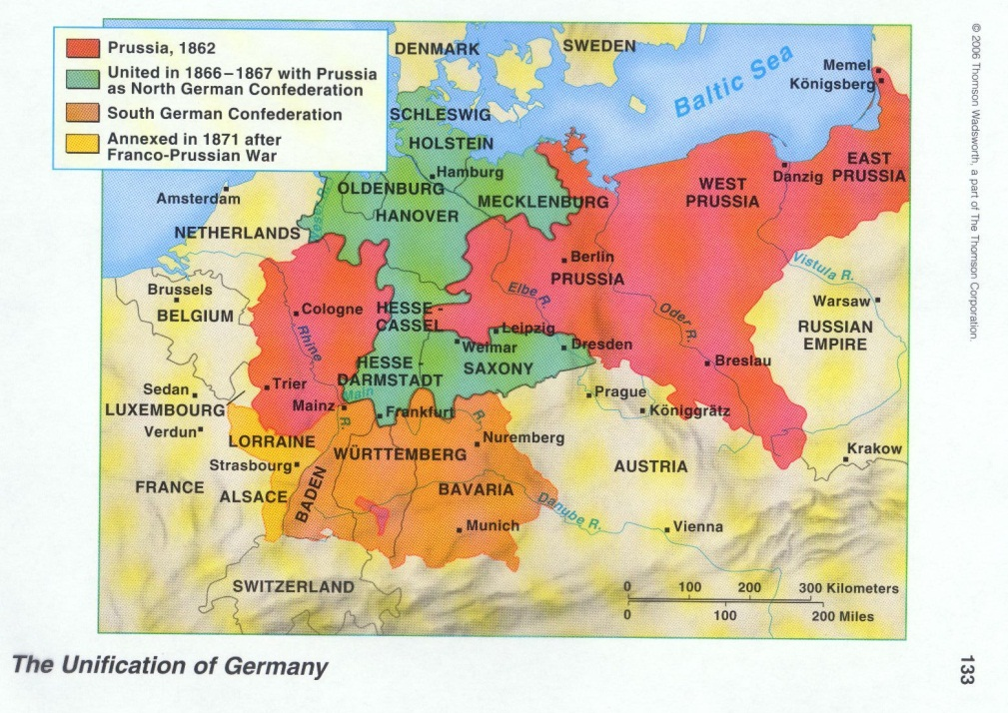
Germany
Bismark and Wilhelm led three wars:
Defeated Denmark (Austria and Prussia formed an alliance to take land from Denmark)
Defeated Austria (created border conflicts so that Austria would declare war – Seven Weeks War)
Franco-Prussian War (against France) – Bismark changed the wording of the Ems Telegram to make it look like Wilhelm I had insulted the French ambassador to Prussia. France declares war and loses.
Becomes the strongest nation in Europe

